Slide 1
CampusFix
Student submits
Smart Campus Complaint & Maintenance Tracker
Software Engineering Project
Iqra University, Airport Campus
Instructor: Sir Jahanzaib Khan
Stored in Database
Admin reviews
Muhammad Azam (IU05-0124-0190)
Kashif Raza (IU05-0124-0303)
Tehreem Ijaz (IU05-0124-0126)
Issue closed
Notes:
Introduce the project as a working desktop GUI application for campus maintenance complaints.

Slide 2
Problem and Proposed Solution
Why this project is useful for a campus environment
Current Problem
Proposed Solution
Complaints are often shared verbally or through informal messages.
There is no clear ownership or status history.
Maintenance follow-up can be delayed because records are not centralized.
A desktop GUI for complaint submission and tracking.
Admin dashboard for assigning, filtering and closing complaints.
SQLite database keeps a complete local record of users and complaints.
Result: scattered maintenance messages become a clear, searchable workflow.
CampusFix | 2/12
Notes:
Explain the real problem first, then show how CampusFix solves it without making the scope too large.

Slide 3
Project Objectives and Scope
Administration
Complaint Submission
Users enter category, location, priority and description.
Admin assigns complaints and updates progress.
Tracking
Dashboard
Users can view status and admin notes.
Basic counts help understand open, pending and closed issues.
Scope limit: local desktop application. Web hosting, notifications and image attachments are kept as future work.
CampusFix | 3/12
Notes:
Clarify the included features and the features that are intentionally outside the first version.

Slide 4
SDLC Model Used and Why
Selected model: Iterative & Incremental Model
Waterfall
Full Agile
Used: Iterative + Incremental
Good for teams with regular customer meetings.
Too much ceremony for a small project.
Built in small working parts: database, login, user GUI, admin GUI and tests.
Each increment was testable before moving ahead.
Best fit for limited time and controlled scope.
Easy to plan, but changes are difficult after design.
Not ideal because GUI feedback may require updates.
DB
Login
User
Admin
Test
CampusFix | 4/12
Notes:
Say clearly: we used Iterative and Incremental Model because the application could be completed in small testable modules.

Slide 5
Functional Requirements and User Roles
Core behavior expected from the system
FR-01
Register and login users
Student / Staff
FR-02
Submit complaint with category, location and priority
Creates complaints
Tracks own complaints
Views dashboard counts
FR-03
Track complaint status and admin note
FR-04
Search and filter records
FR-05
Assign complaints and update progress
Admin / Maintenance
FR-06
Show dashboard statistics
Views all complaints
Assigns technician
Updates status and notes
CampusFix | 5/12
Notes:
Connect the main requirements to the two user roles.

Slide 6
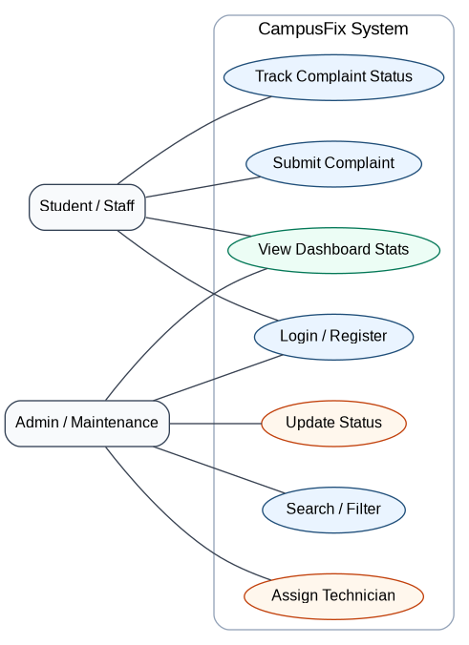
Use Case Diagram
CampusFix | 6/12
Notes:
Explain that both actors log in, but only admin can assign and update complaint progress.

Slide 7
System Architecture and UML Component View
Presentation Layer
Tkinter GUI: login, user dashboard, admin dashboard
User
Actor
Application Logic
validation, role checks, complaint workflow, dashboard counts
Data Access Module
database.py handles SQL insert, update, search and statistics
Admin
Actor
SQLite Database
users + complaints
CampusFix | 7/12
Notes:
Use this slide to explain architecture instead of showing a blurry component diagram image.

Slide 8
Database Design / ERD
COMPLAINTS
USERS
complaint_id (PK)
user_id (PK)
user_id (FK)
name
category
email (unique)
location
1 user → many complaints
priority
password_hash
status
role
assigned_to
created_at
admin_note
created_at
updated_at
CampusFix | 8/12
Notes:
Explain the one-to-many relationship and why the database is intentionally not overcomplicated.

Slide 9
Complaint Submission Sequence
Student
User GUI
Database Module
SQLite DB
Admin GUI
enter complaint details
validate and call save
INSERT complaint
saved id returned
success response
fetch pending complaints
complaint list shown
CampusFix | 9/12
Notes:
Walk through the sequence from left to right.

Slide 10
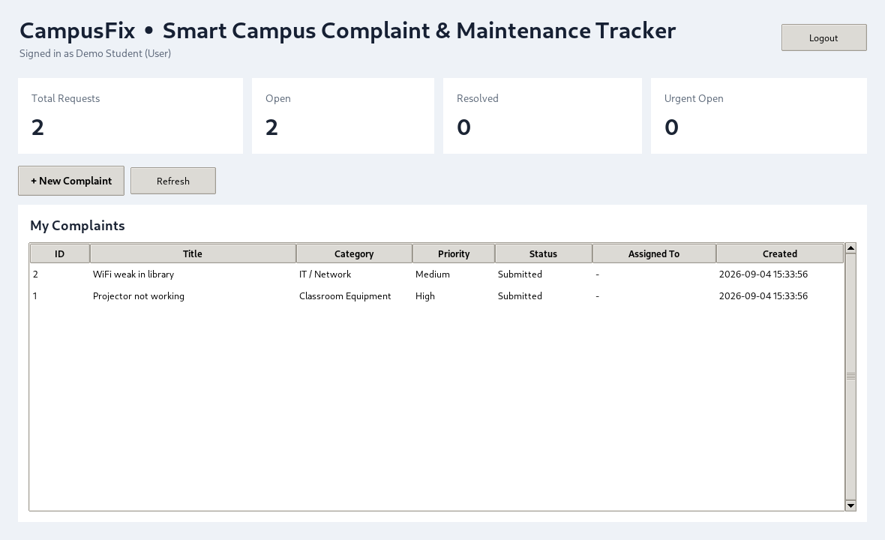
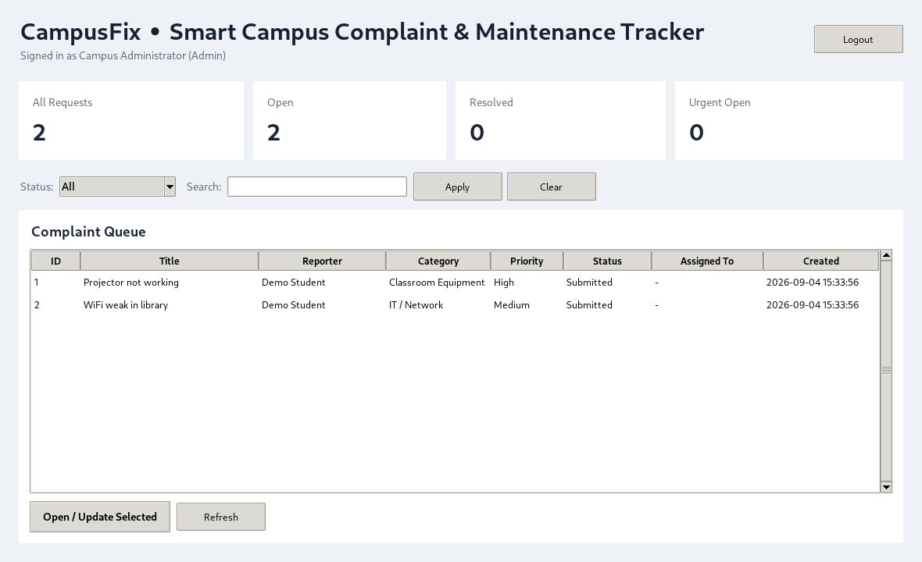
Implemented GUI Screenshots
Working Python Tkinter desktop application
User Dashboard
Admin Dashboard
Submit complaint + track own records
Filter, assign, update status and notes
CampusFix | 10/12
Notes:
Show that the application has a real interface and is not only a design document.

Slide 11
Testing and Validation
Validation Checks
Testing Result
Login
Valid users open correct dashboard
Registration
Duplicate emails are rejected
Manual GUI checks + automated database unit tests confirm that the core workflow is working.
Complaint Form
Required fields are checked before saving
Admin Update
Status, assigned person and notes are saved
✓
Dashboard
Counts refresh after records change
Database Tests
Core operations passed: 3 / 3
CampusFix | 11/12
Notes:
This replaces the blurry testing image with a clean table and a clear pass result.

Slide 12
Conclusion
Final project summary
CampusFix is a moderate, working, and explainable Software Engineering project. It covers requirements, SDLC model selection, UML design, database design, GUI implementation, testing, and documentation.
Thank You!
CampusFix | 12/12
Notes:
End by emphasizing that the project is practical and can be extended later.

